Slide 1
Some Extraordinary Statistics
Gordon Price
Director of the SFU City Program
January 28, 2015 | Hilton Metrotown, Burnaby

Slide 2
Extraordinary Stat
No. 1

Slide 3
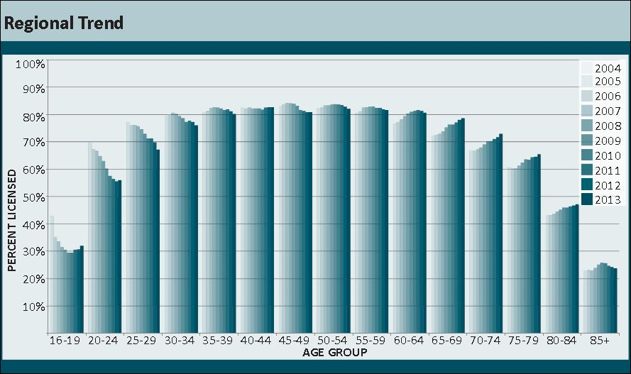
Active Drive Licensing Rates
in Metro Vancouver

Slide 4
Among 16- to 34-year-olds, there has been a steady drop up until the last few years in the percent getting their licences.
The steepest drop has been among young adults, 20-24.

Slide 5
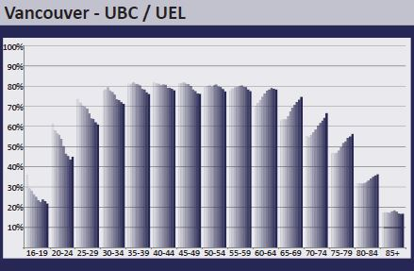
A young adult in the City of Vancouver / UEL with a driver’s licence is in the minority.
50%

Slide 6
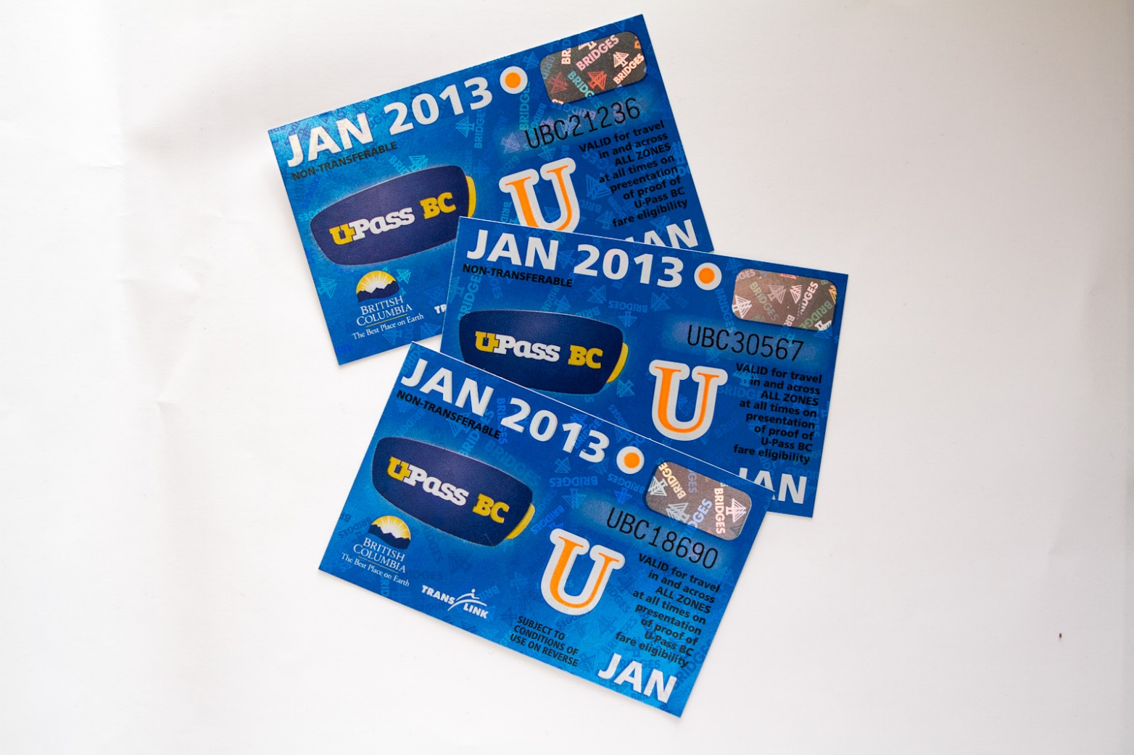

Slide 7
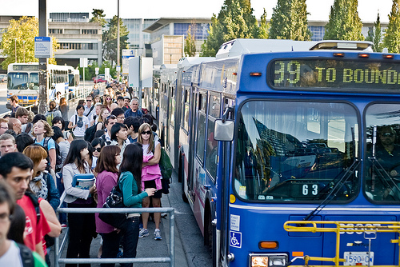

Slide 9
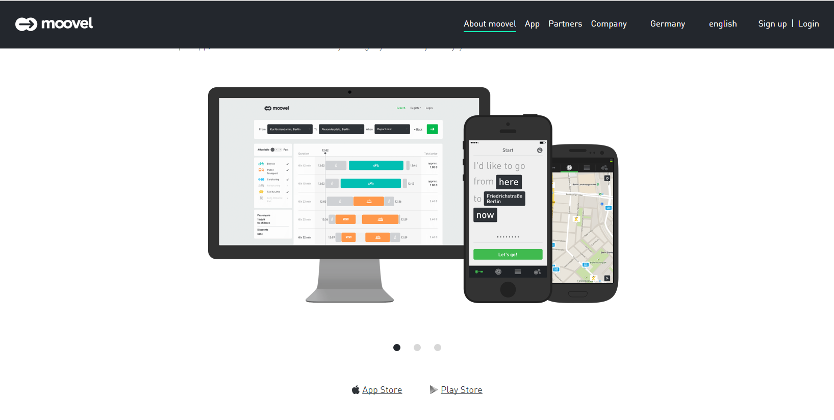
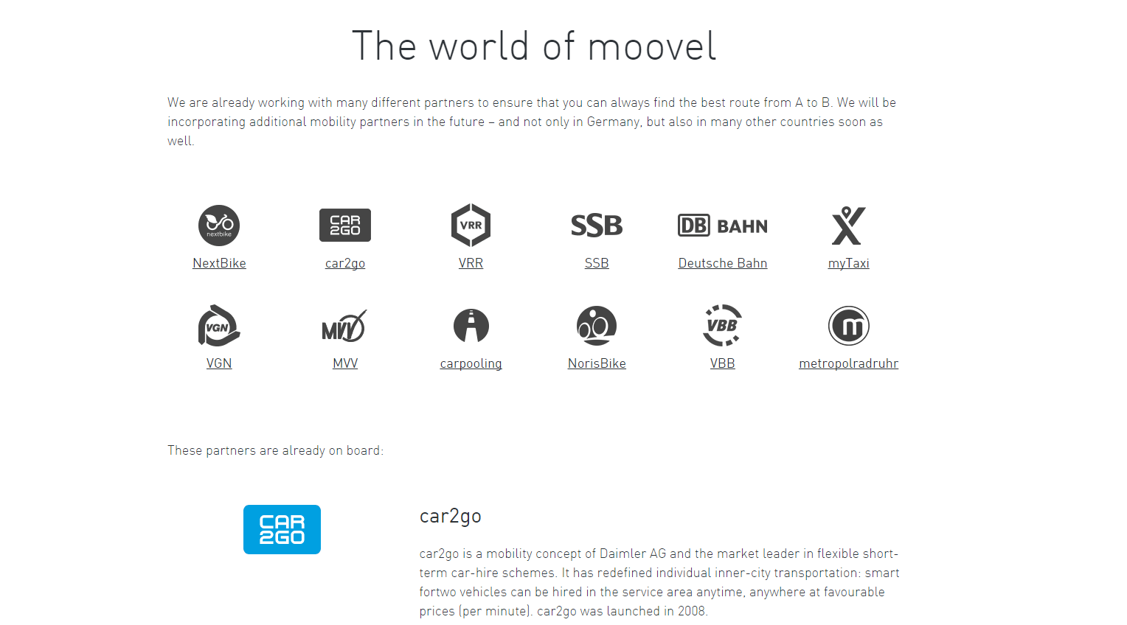

Slide 10
Extraordinary Stat
No. 2

Slide 11
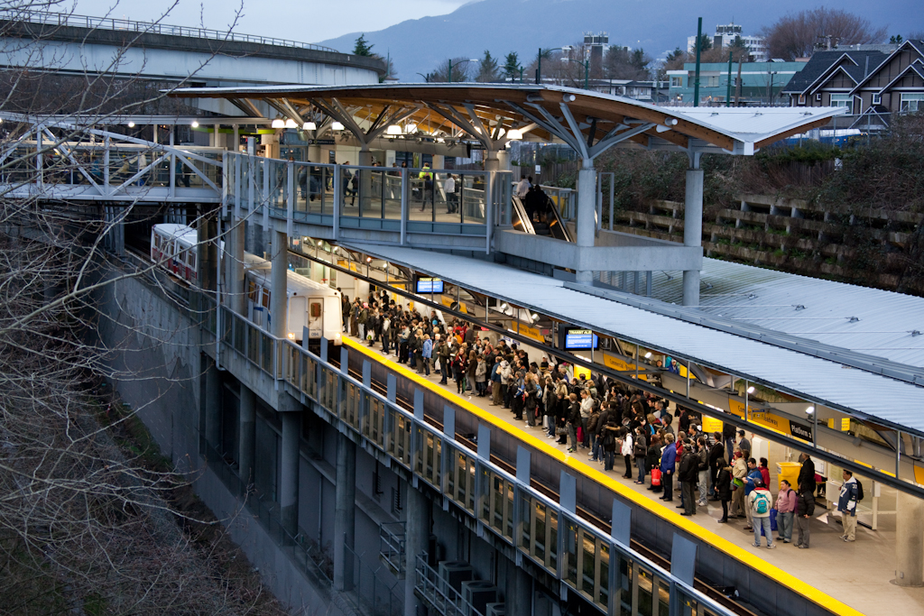
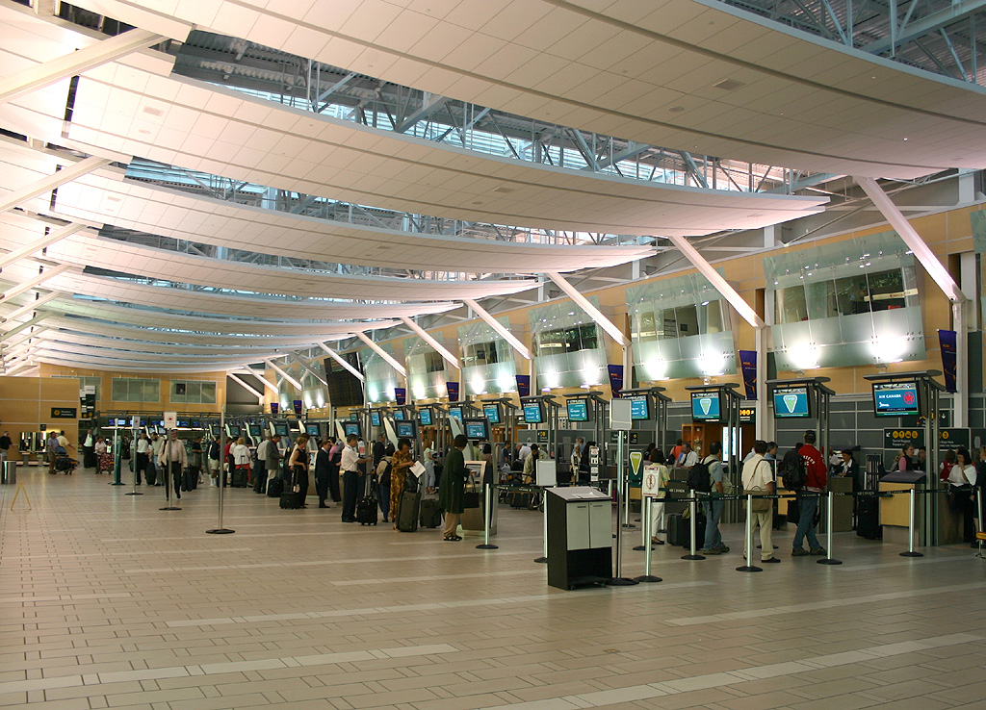
The SkyTrain station at Commercial and Broadway gets more traffic than YVR airport.

Slide 12
The Broadway Corridor:
The busiest bus route in the U.S. and Canada

Slide 13
B-Line & the Broadway Corridor
Carries about half the hundred-thousand transit users in the Broadway corridor - a transit usage equal to the Canada Line
The Broadway Corridor has half the trips of Downtown with half the transit usage.
Compared to the Central Business District, the potential is actually greater – 35 or 40 percent could be on transit.

Slide 14
Extraordinary Stat
No. 3

Slide 15
Traffic volumes in and out of Downtown Vancouver today are about the same as 1965

Slide 16
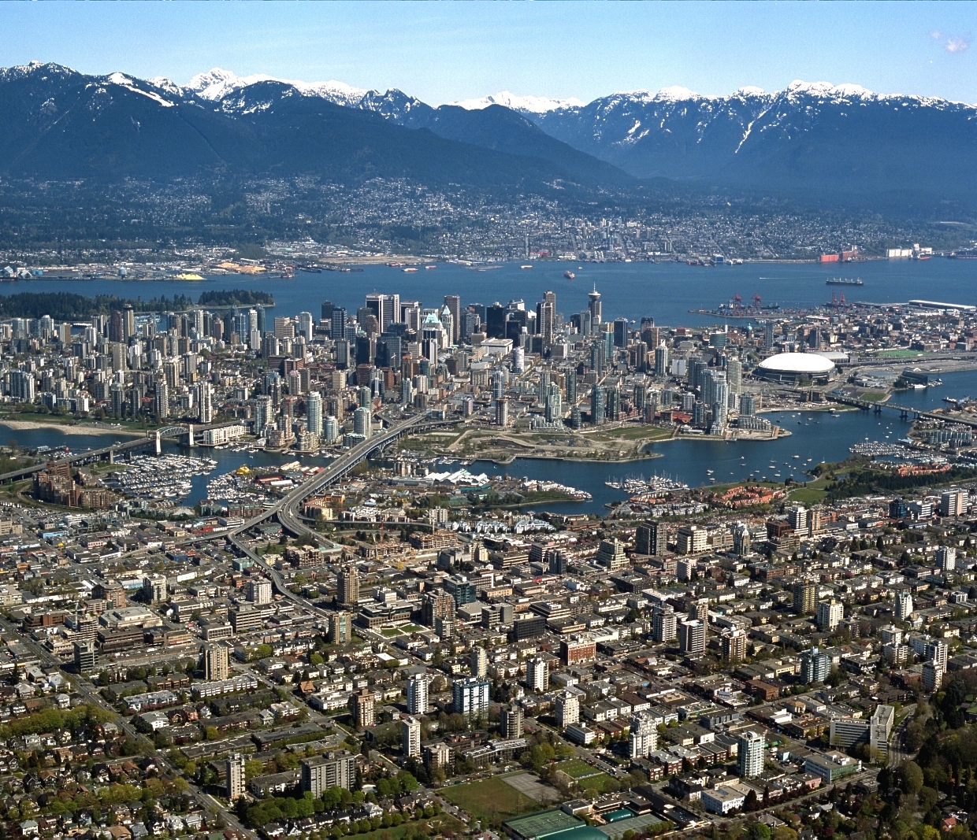
Downtown Vancouver
Screenline

Slide 17
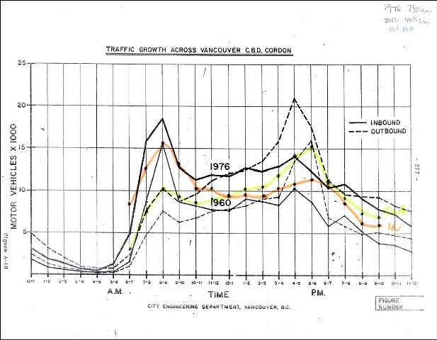
Traffic into Downtown Vancouver
2010
2010
1976
1976
1960
1960

Slide 18
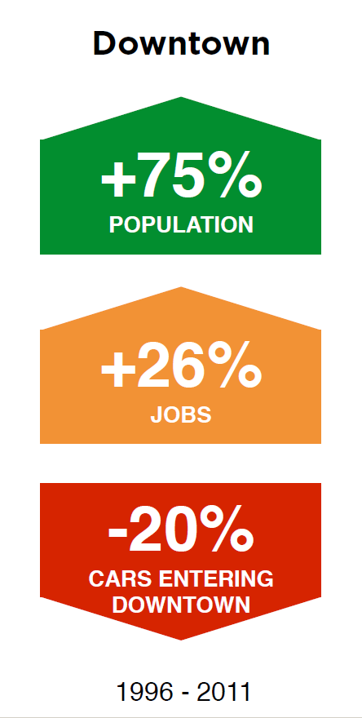
Consequences:
What has this drop in vehicle traffic allowed us to do?

Slide 19
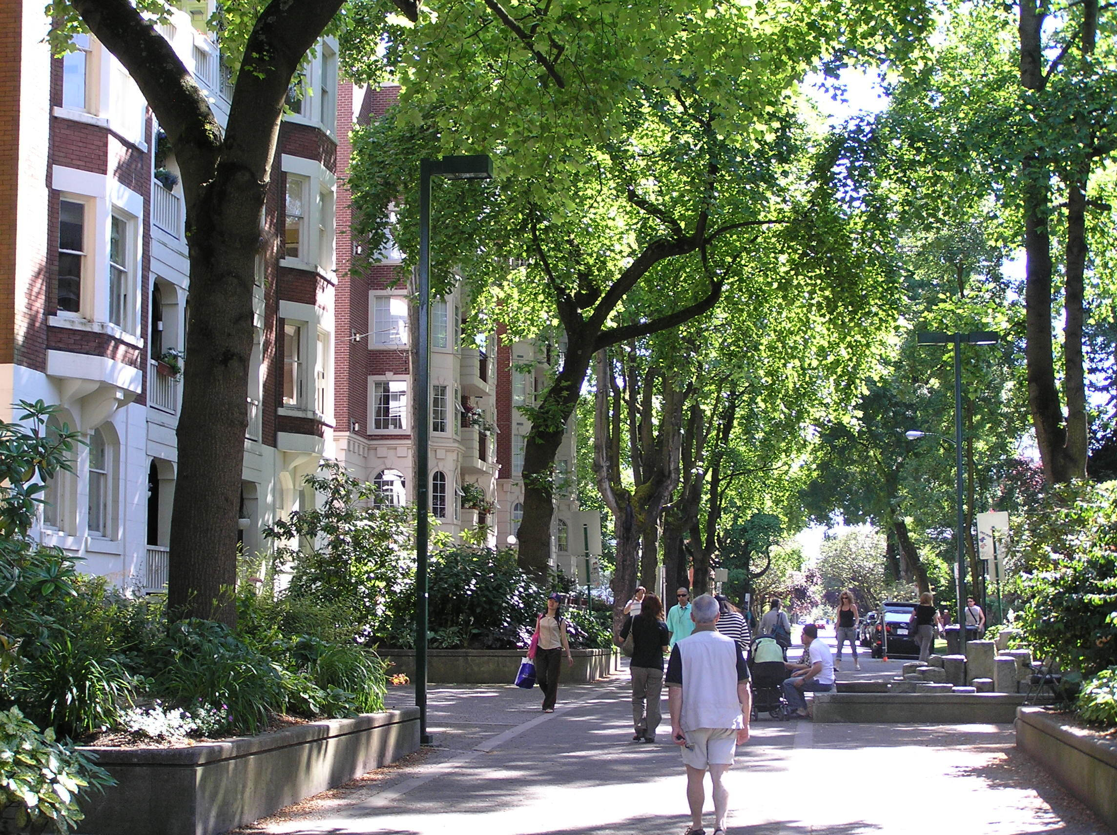
Traffic calming in the West End

Slide 20
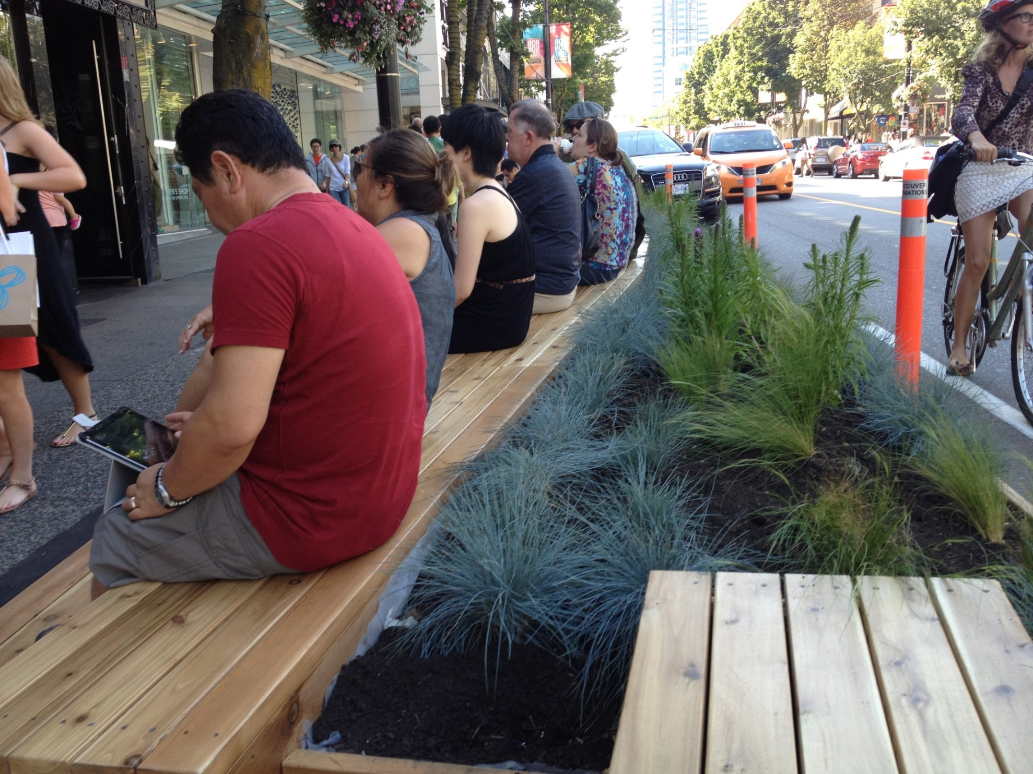
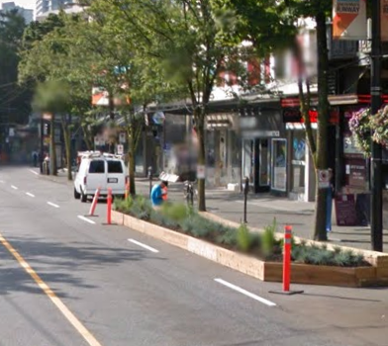
“Urban Pasture”
1000 Block Robson

Slide 21
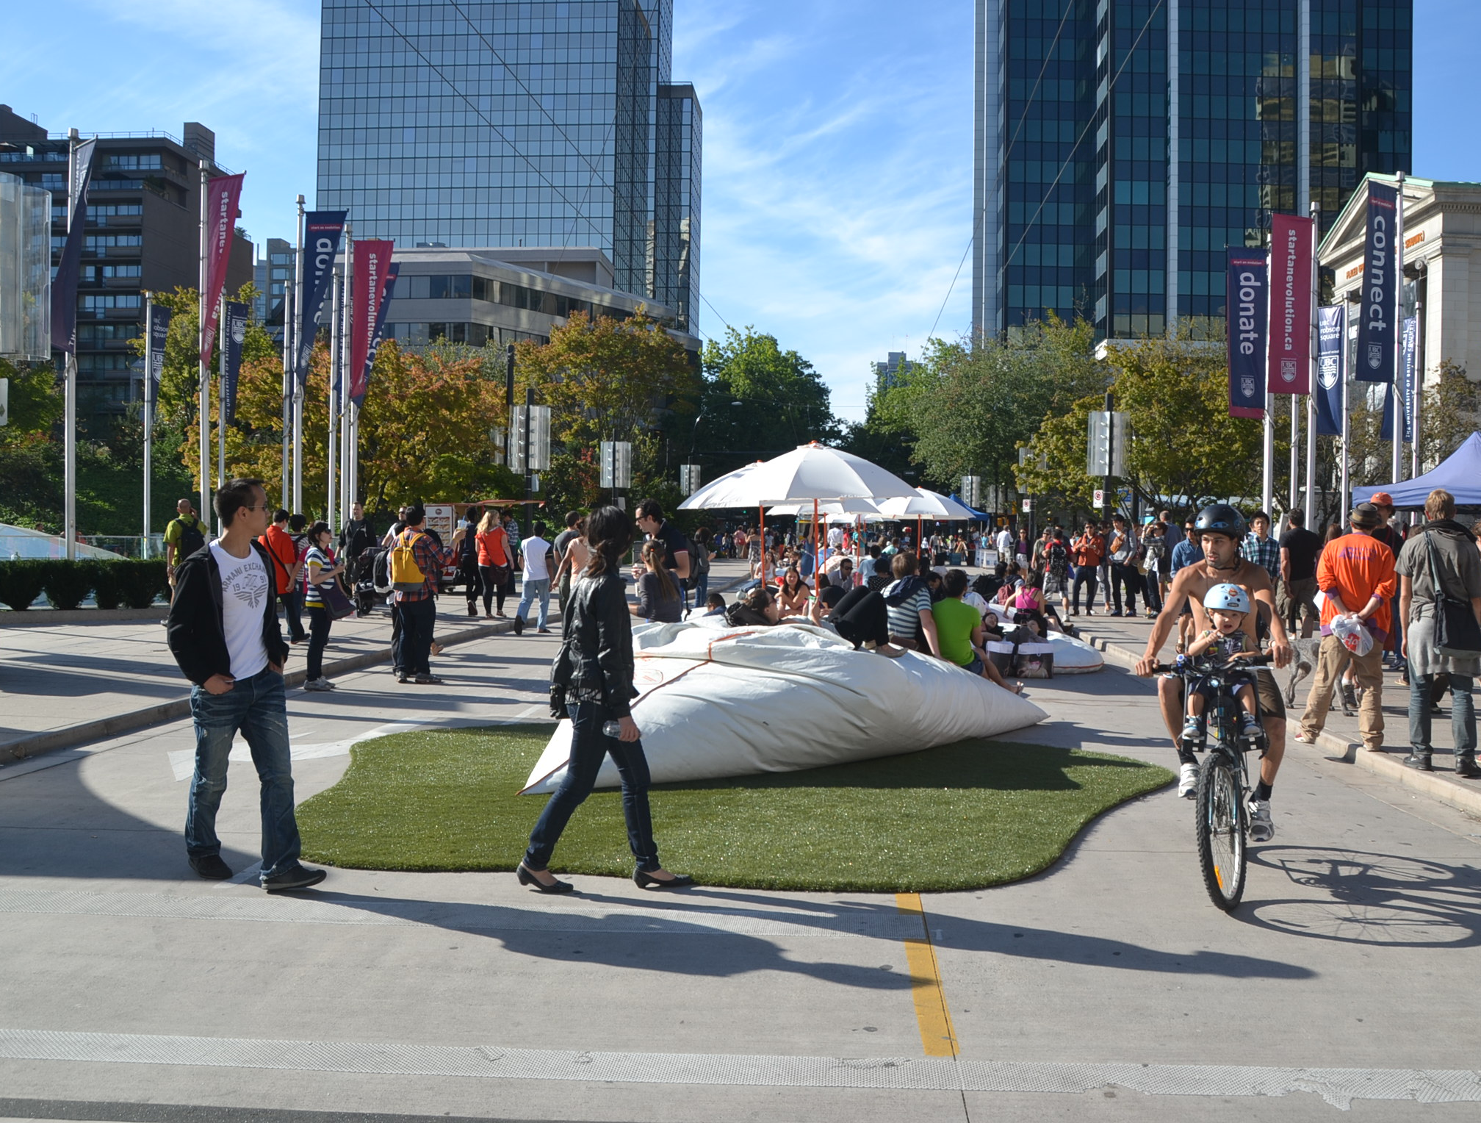
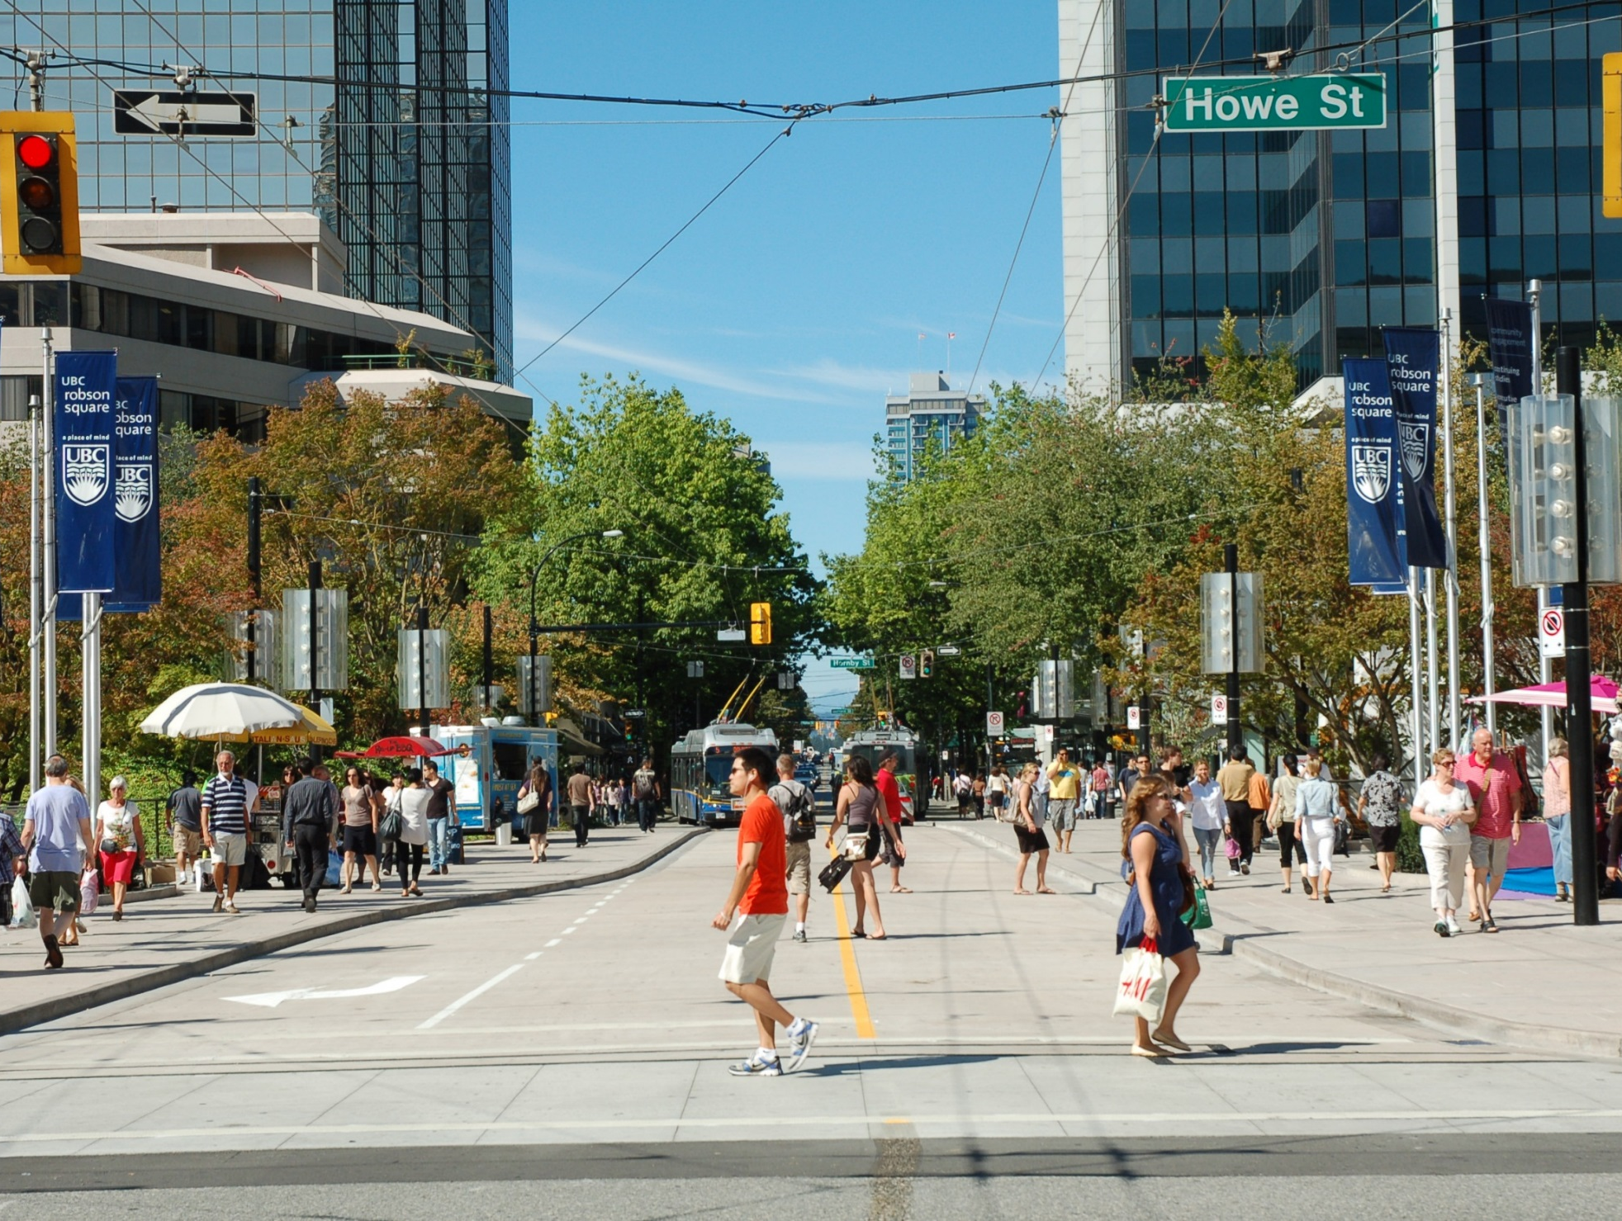
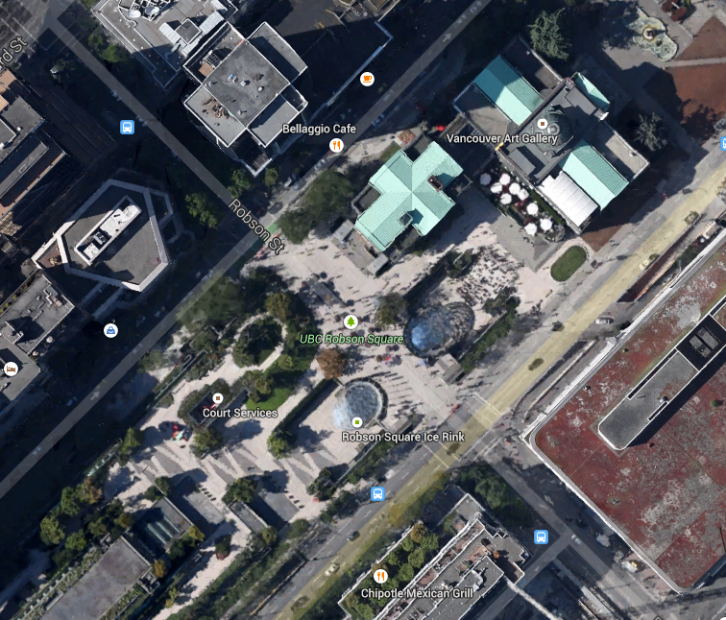
Robson Street
800 Block

Slide 22
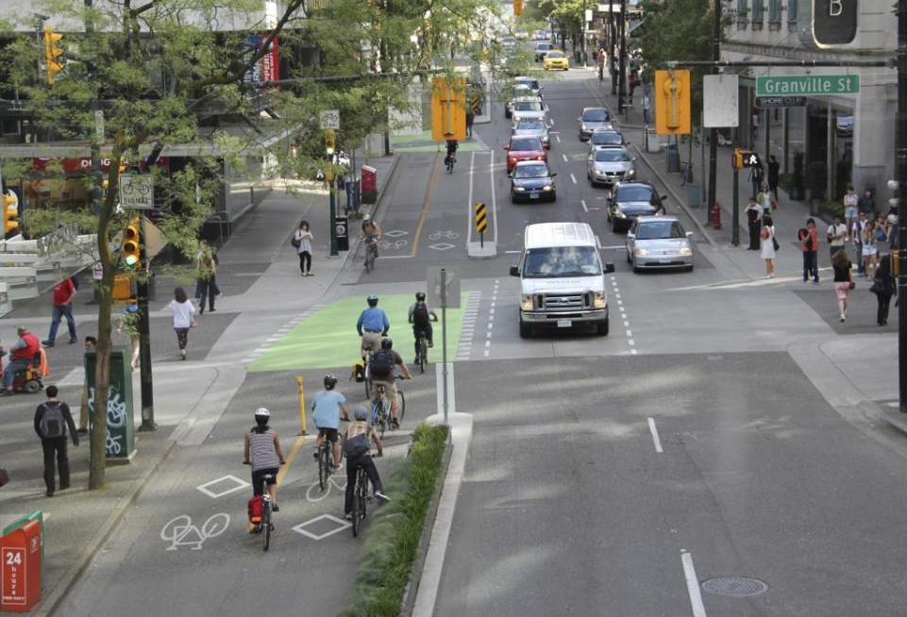
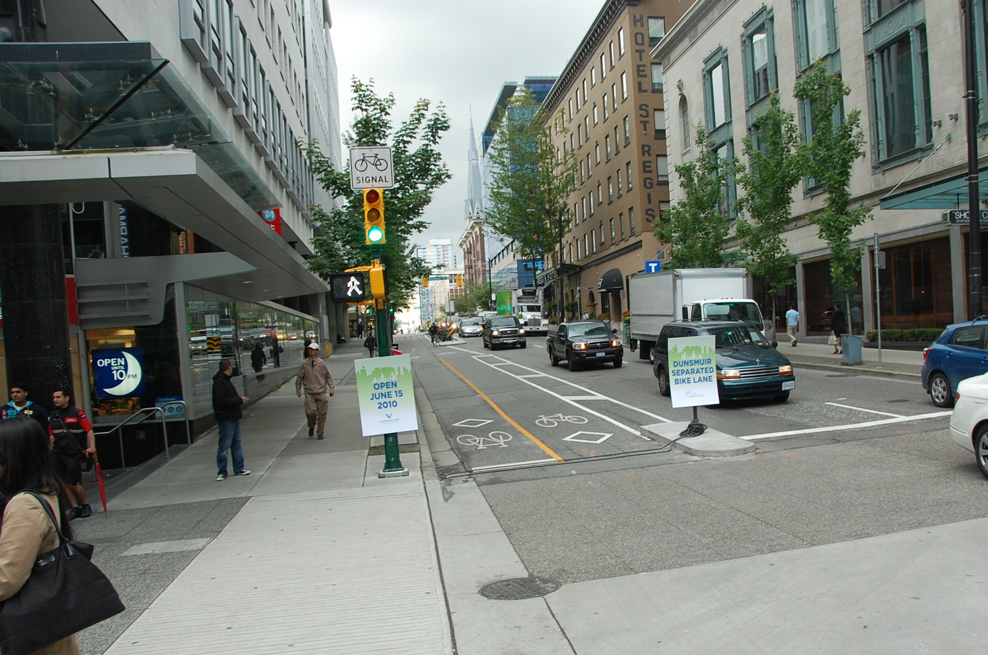
Cycle Track
Dunsmuir

Slide 23
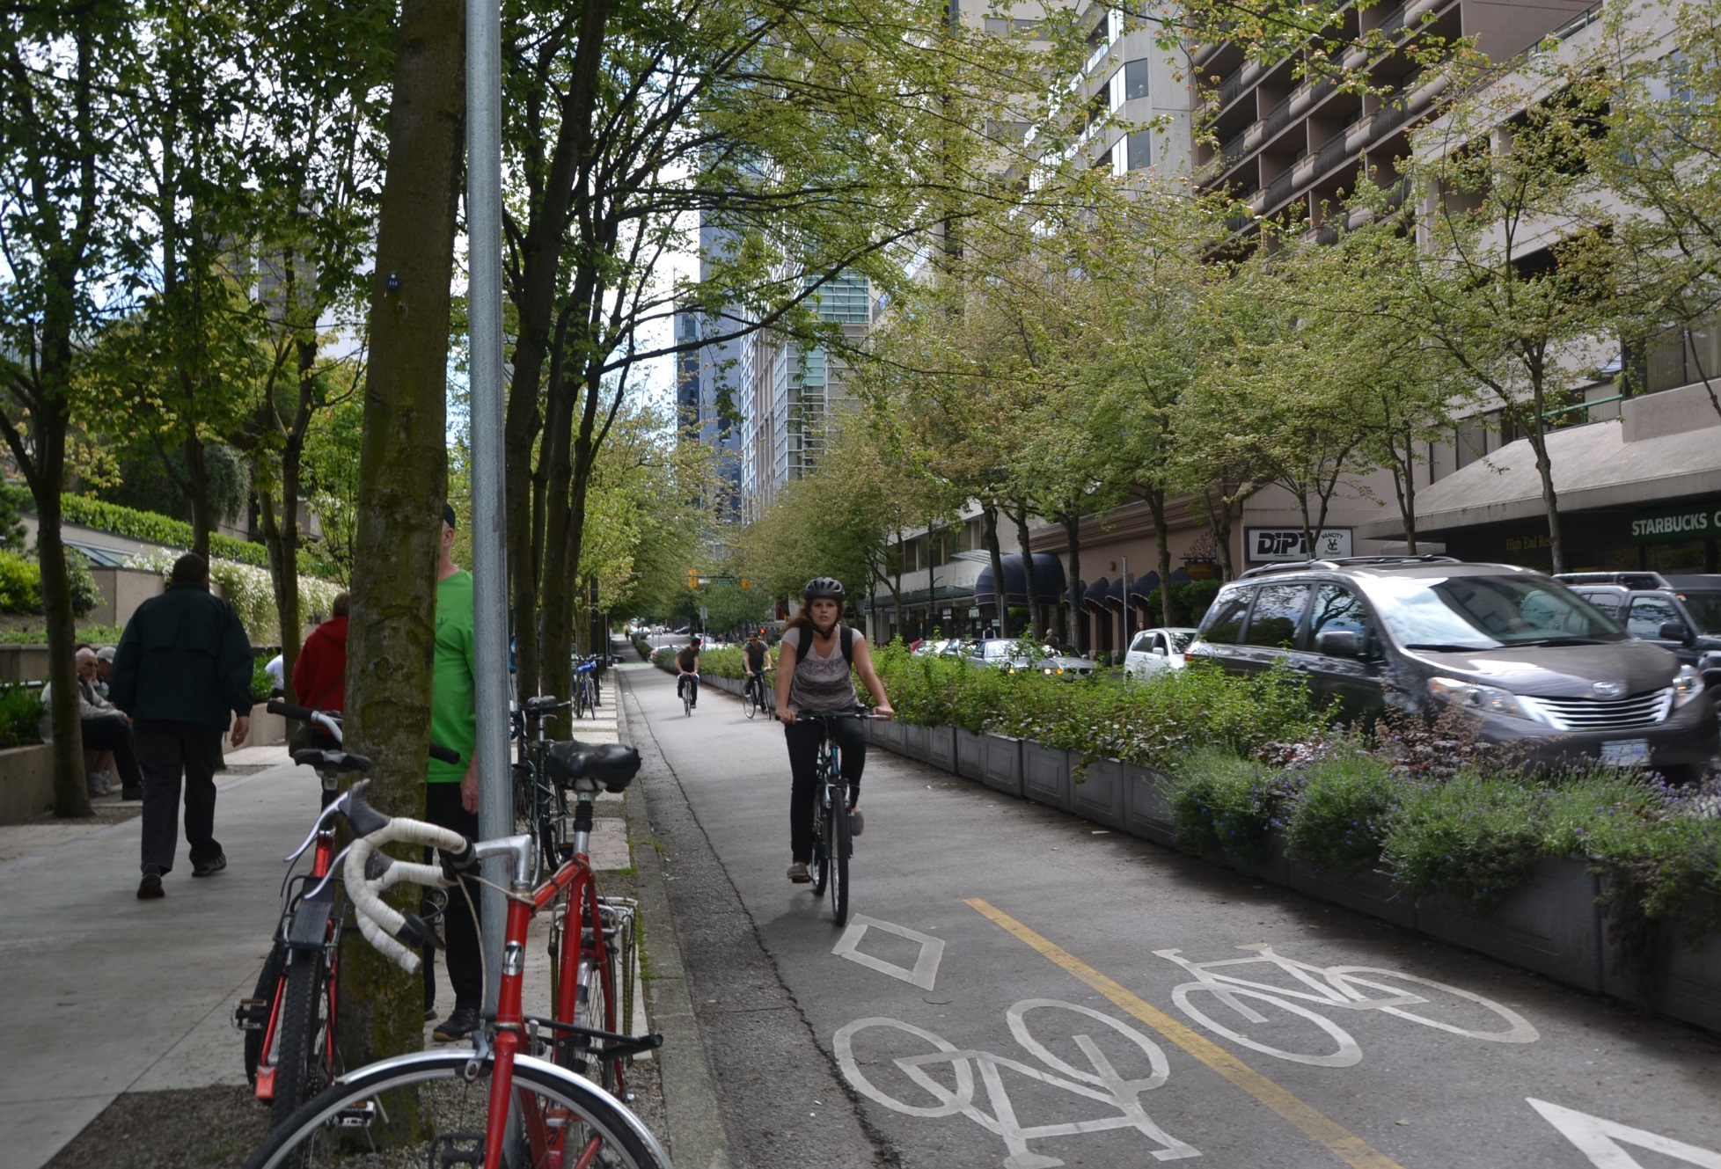
Cycle Track
Hornby

Slide 25
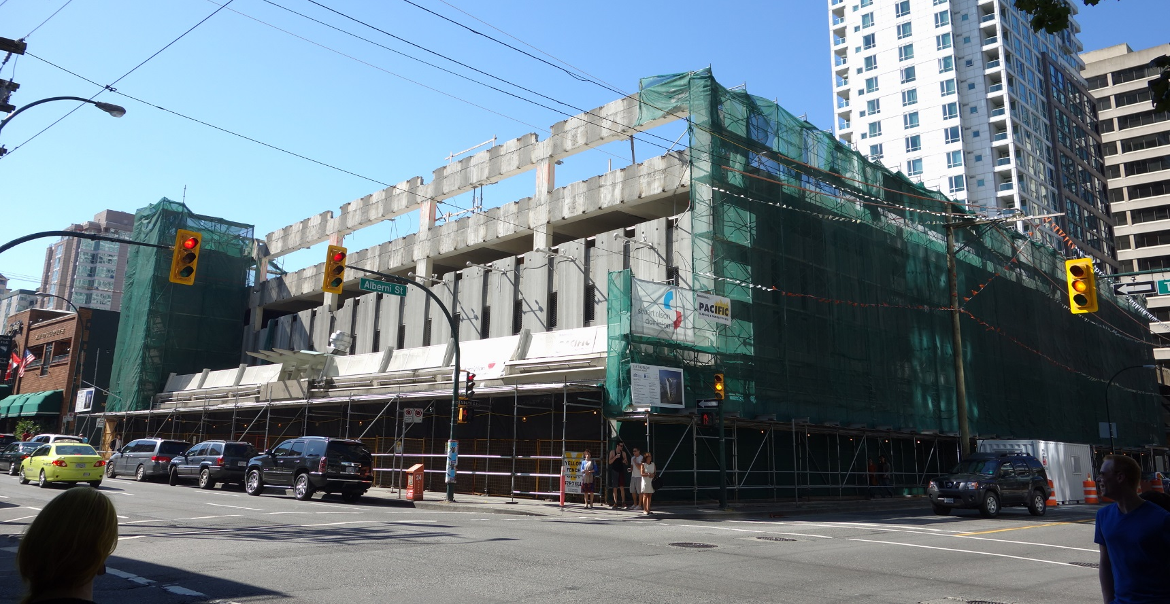
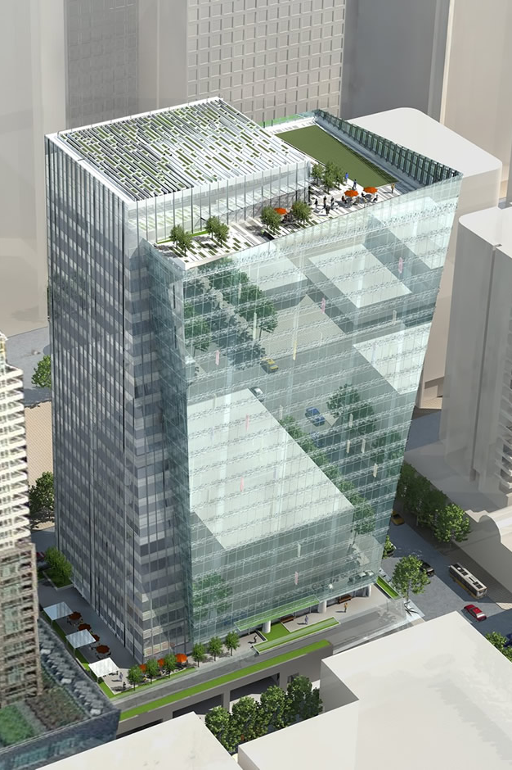
Parking

Slide 26
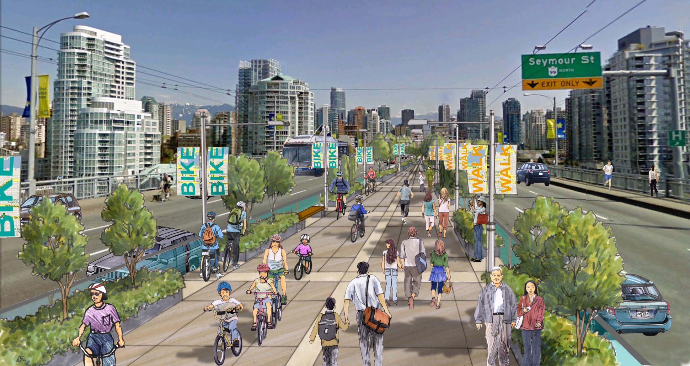
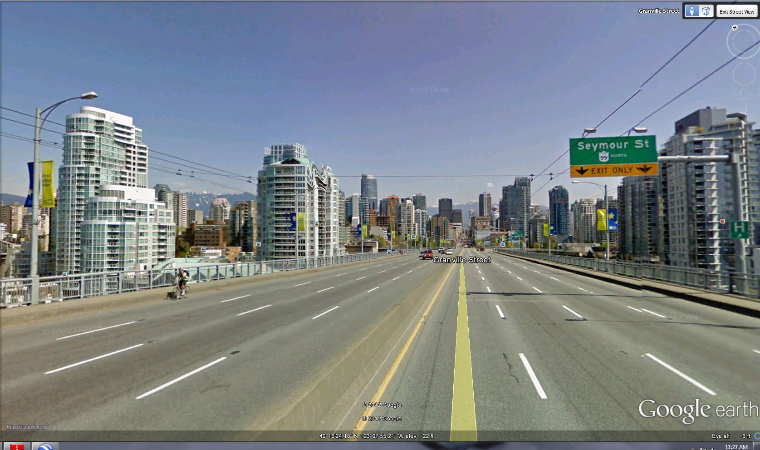
Granville Bridge

Slide 27
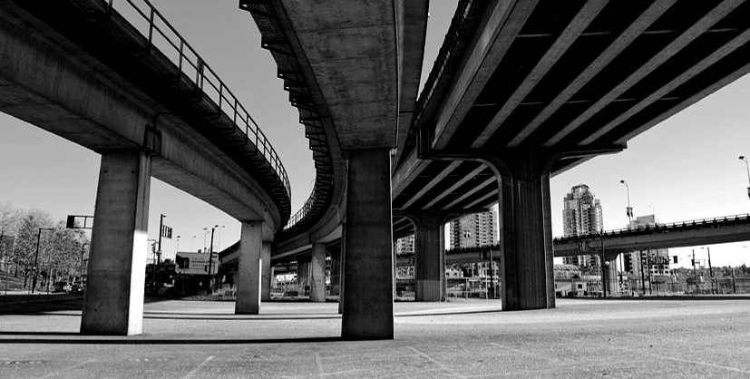
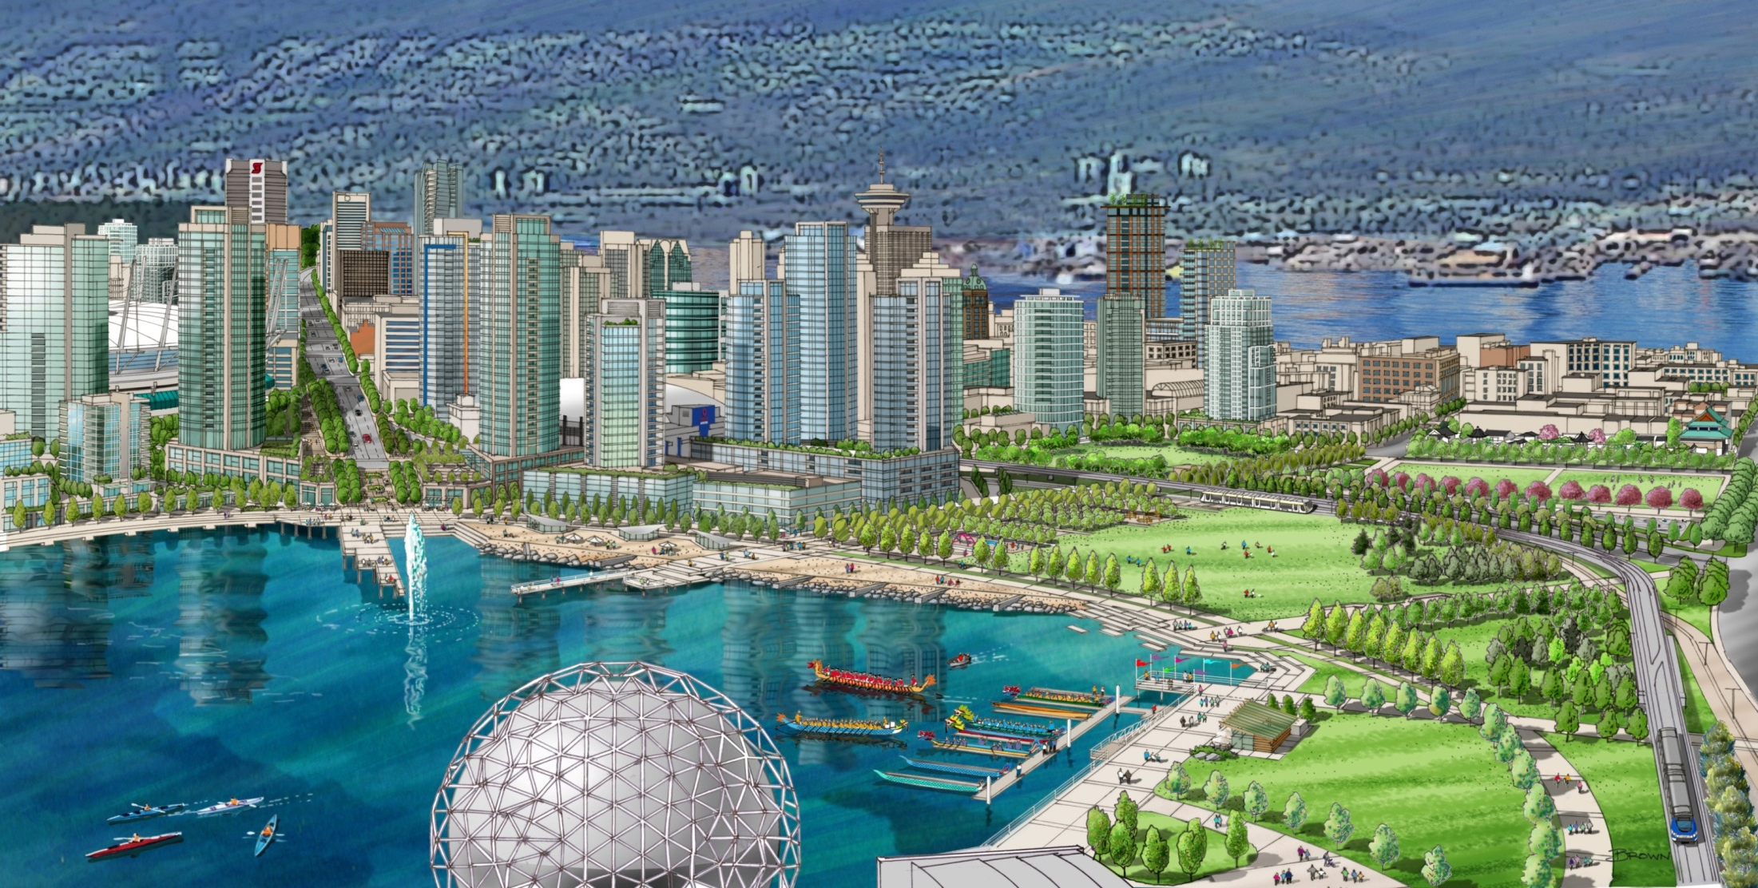
Georgia Viaducts

Slide 28
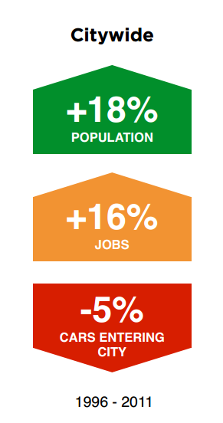
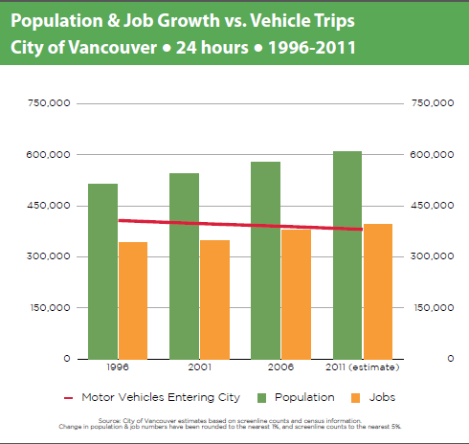

Slide 29
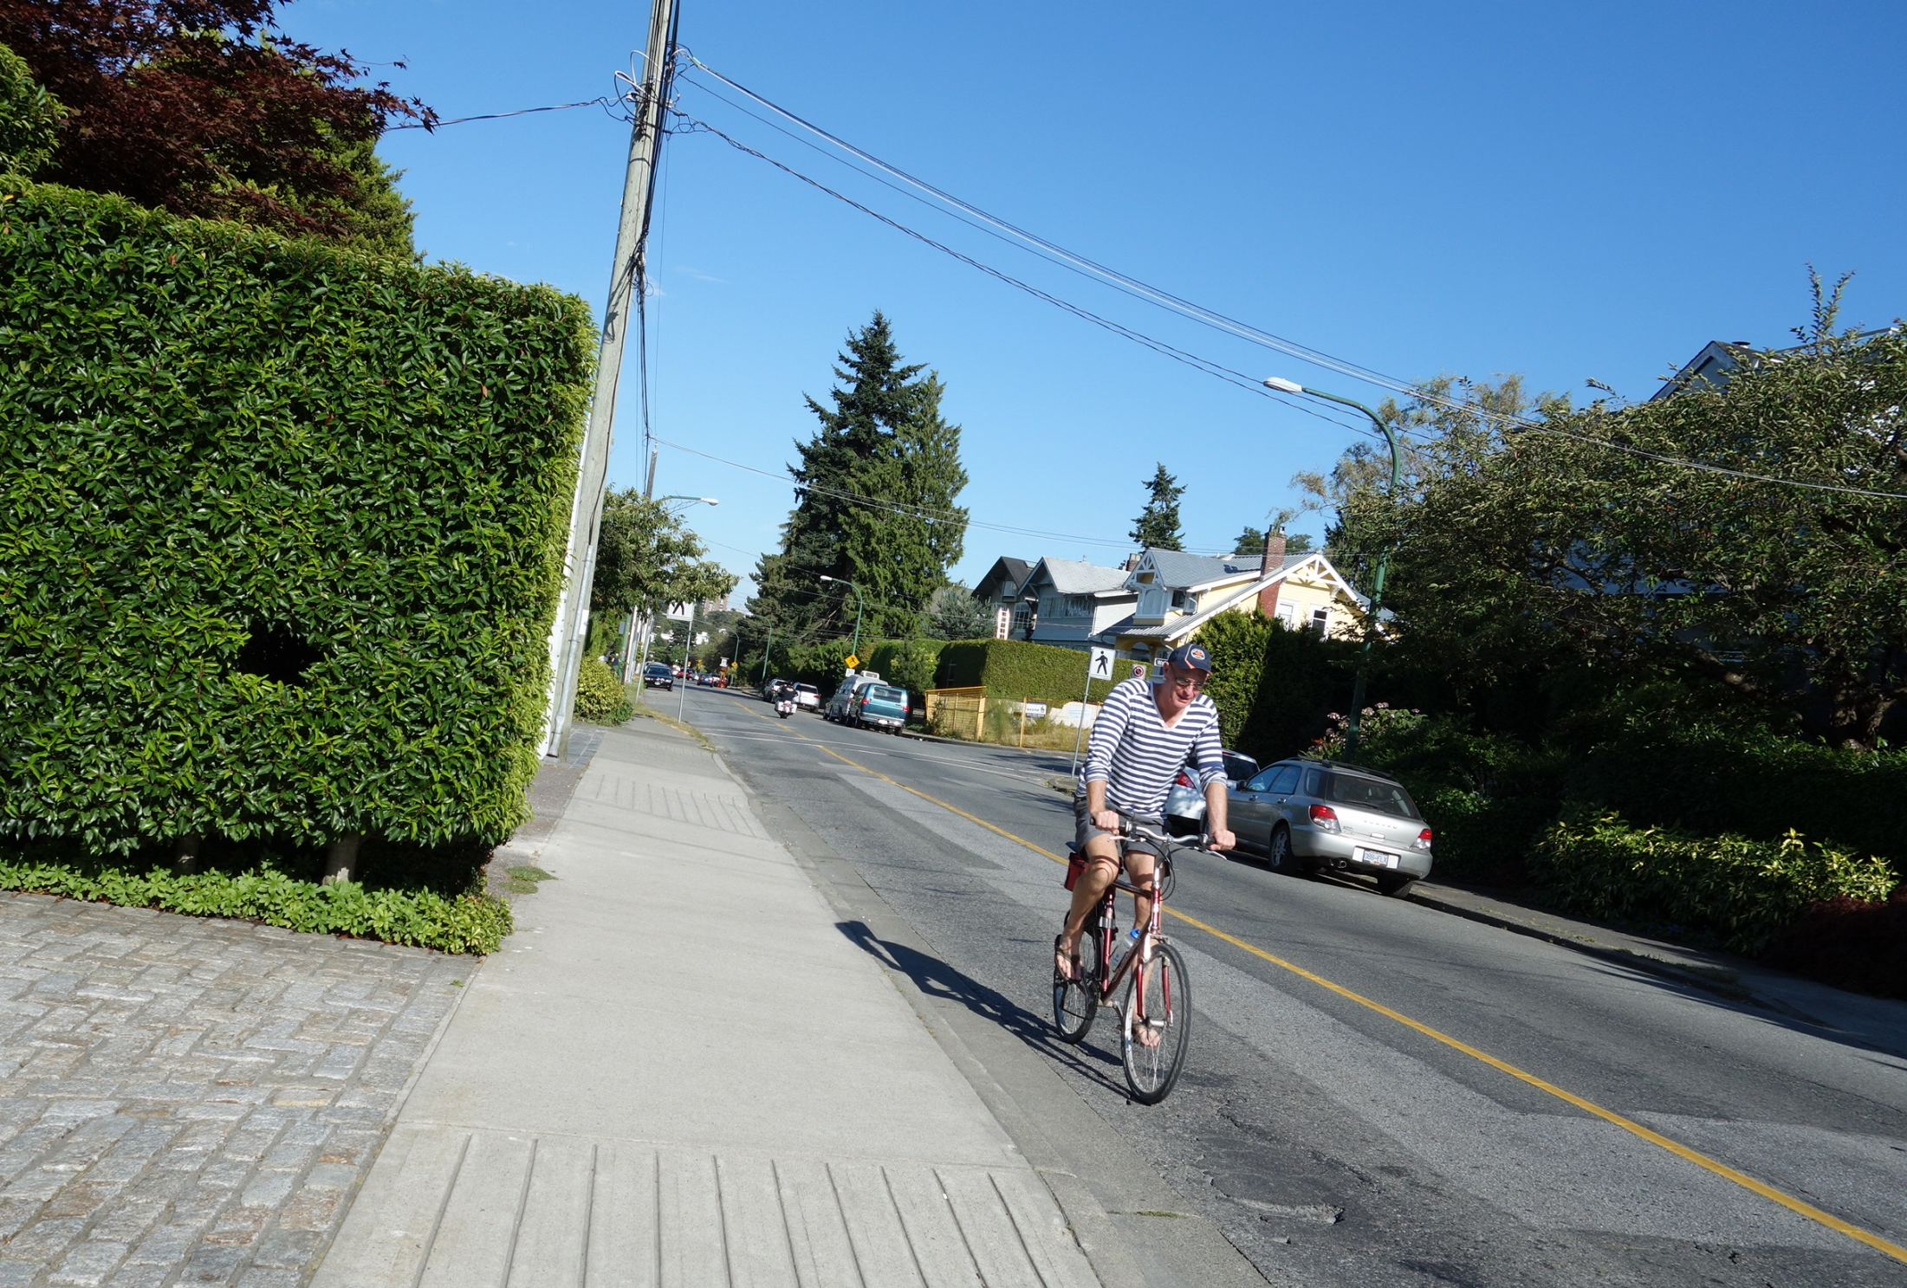
Point Grey Road

Slide 30
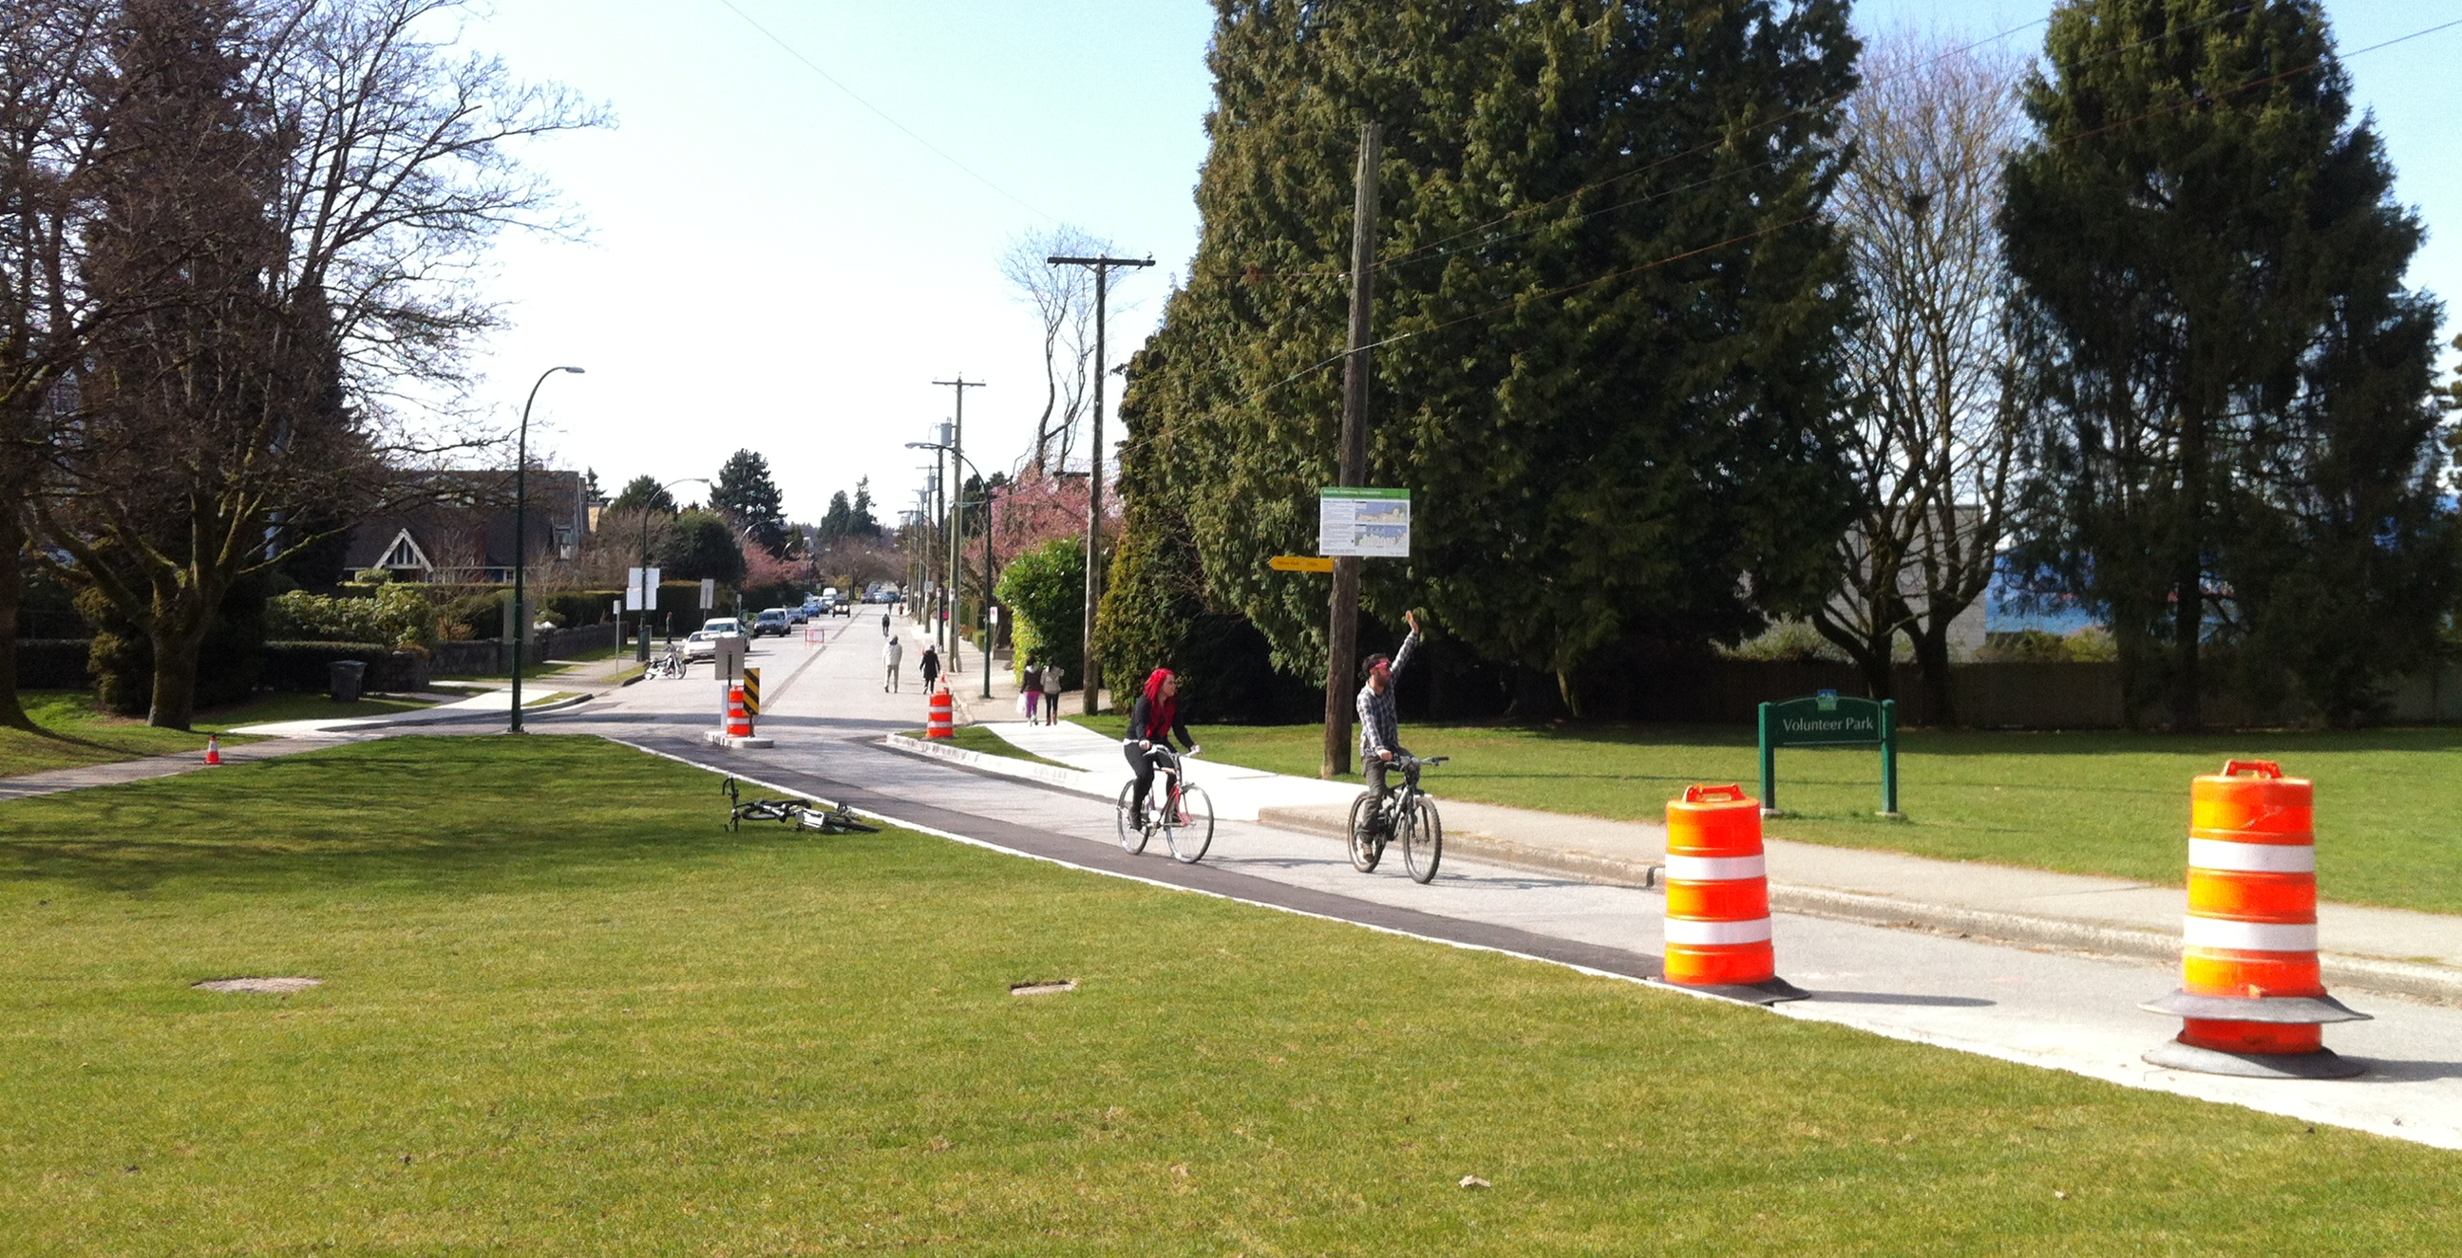

Slide 31
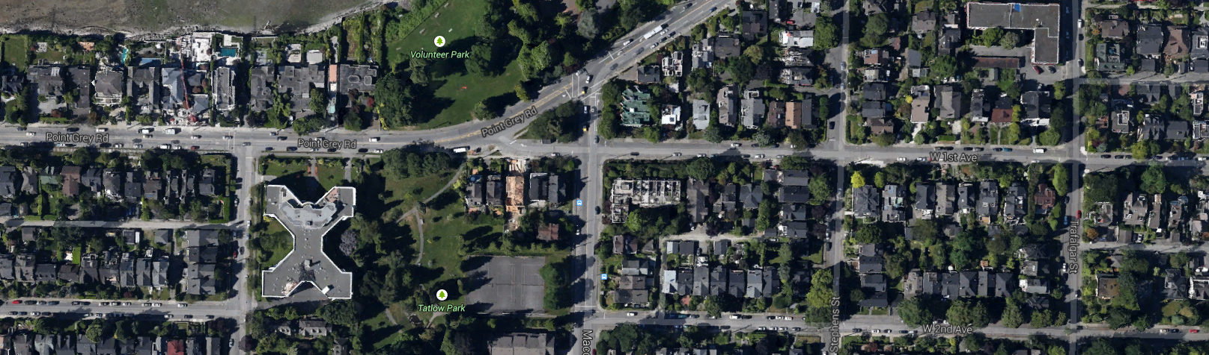
Carmaggedon on Macdonald Street

Slide 32
What is happening to vehicle growth elsewhere?

Slide 33
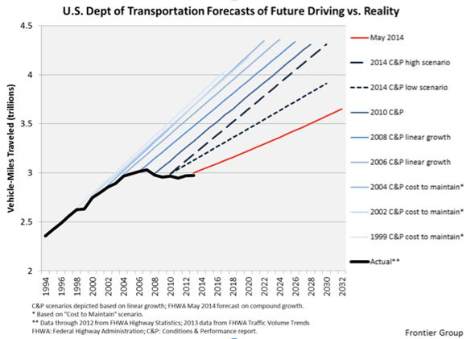
Forecasting Fail: United States

Slide 34
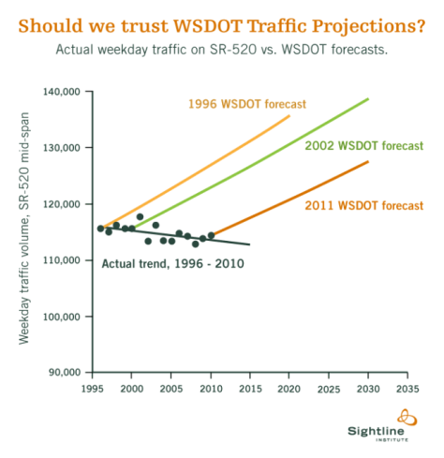
Forecasting Fail: Washington State

Slide 35
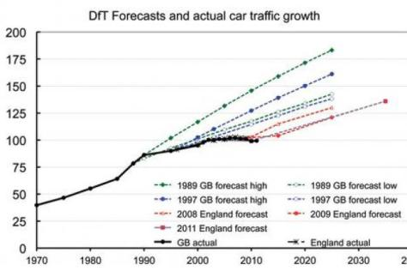
Forecasting Fail: United Kingdom

Slide 36
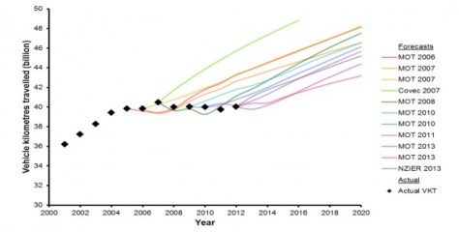
Forecasting Fail: New Zealand

Slide 37
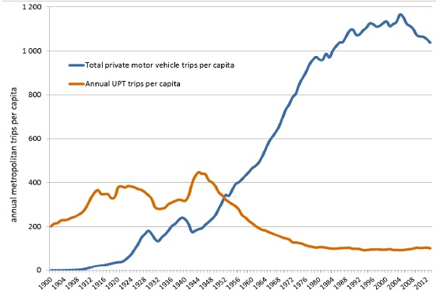
Forecasting Fail: Australia

Slide 38
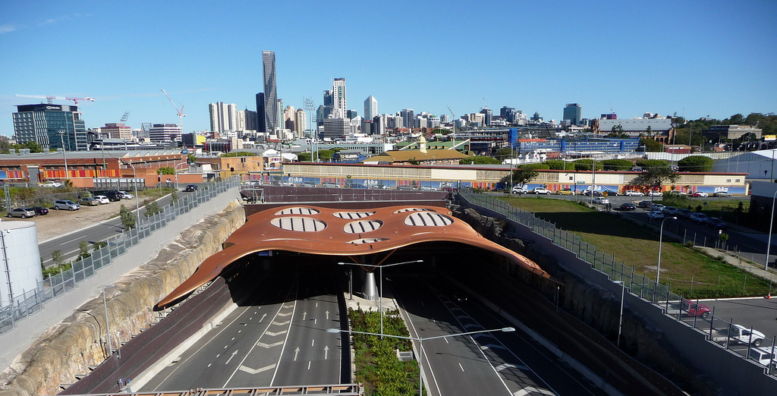
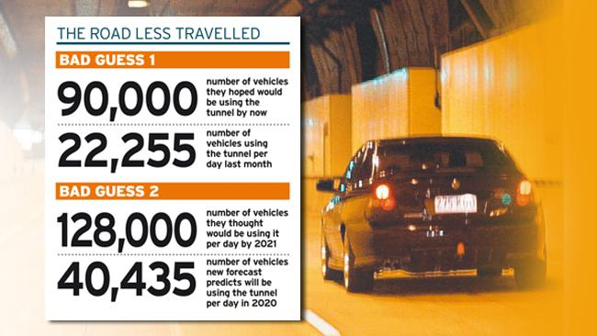
Brisbane: Clem 7 Tunnel

Slide 39
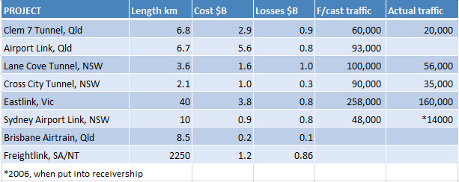

Slide 40
Forecasting Fail: Portugal

Slide 41
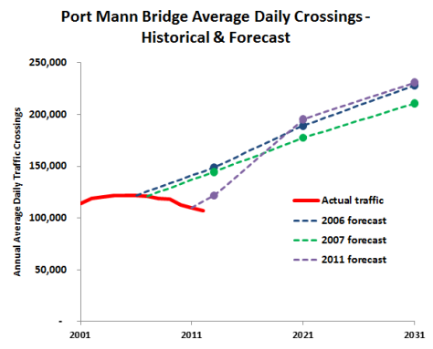
Forecasting Fail: Port Mann Bridge

Slide 42
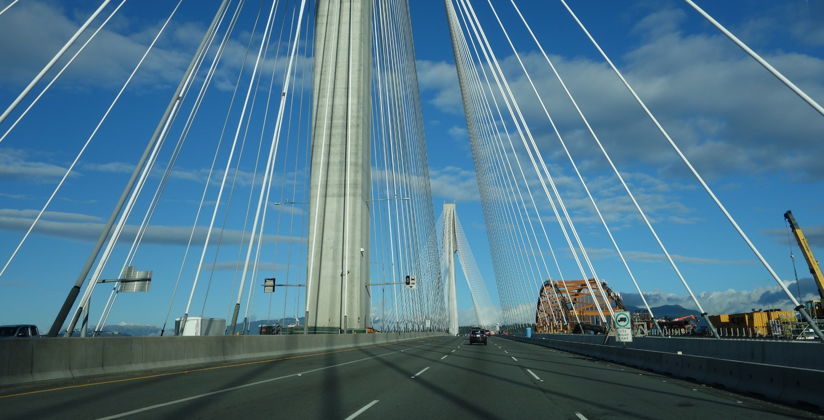
Port Mann Bridge

Slide 43
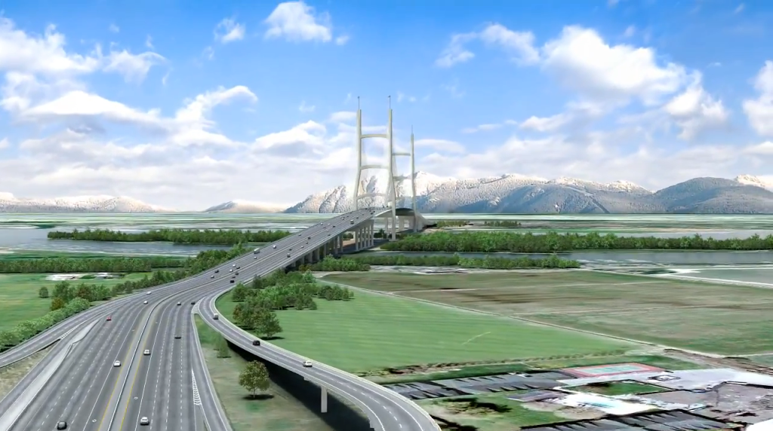
Proposed Massey Bridge

Slide 44
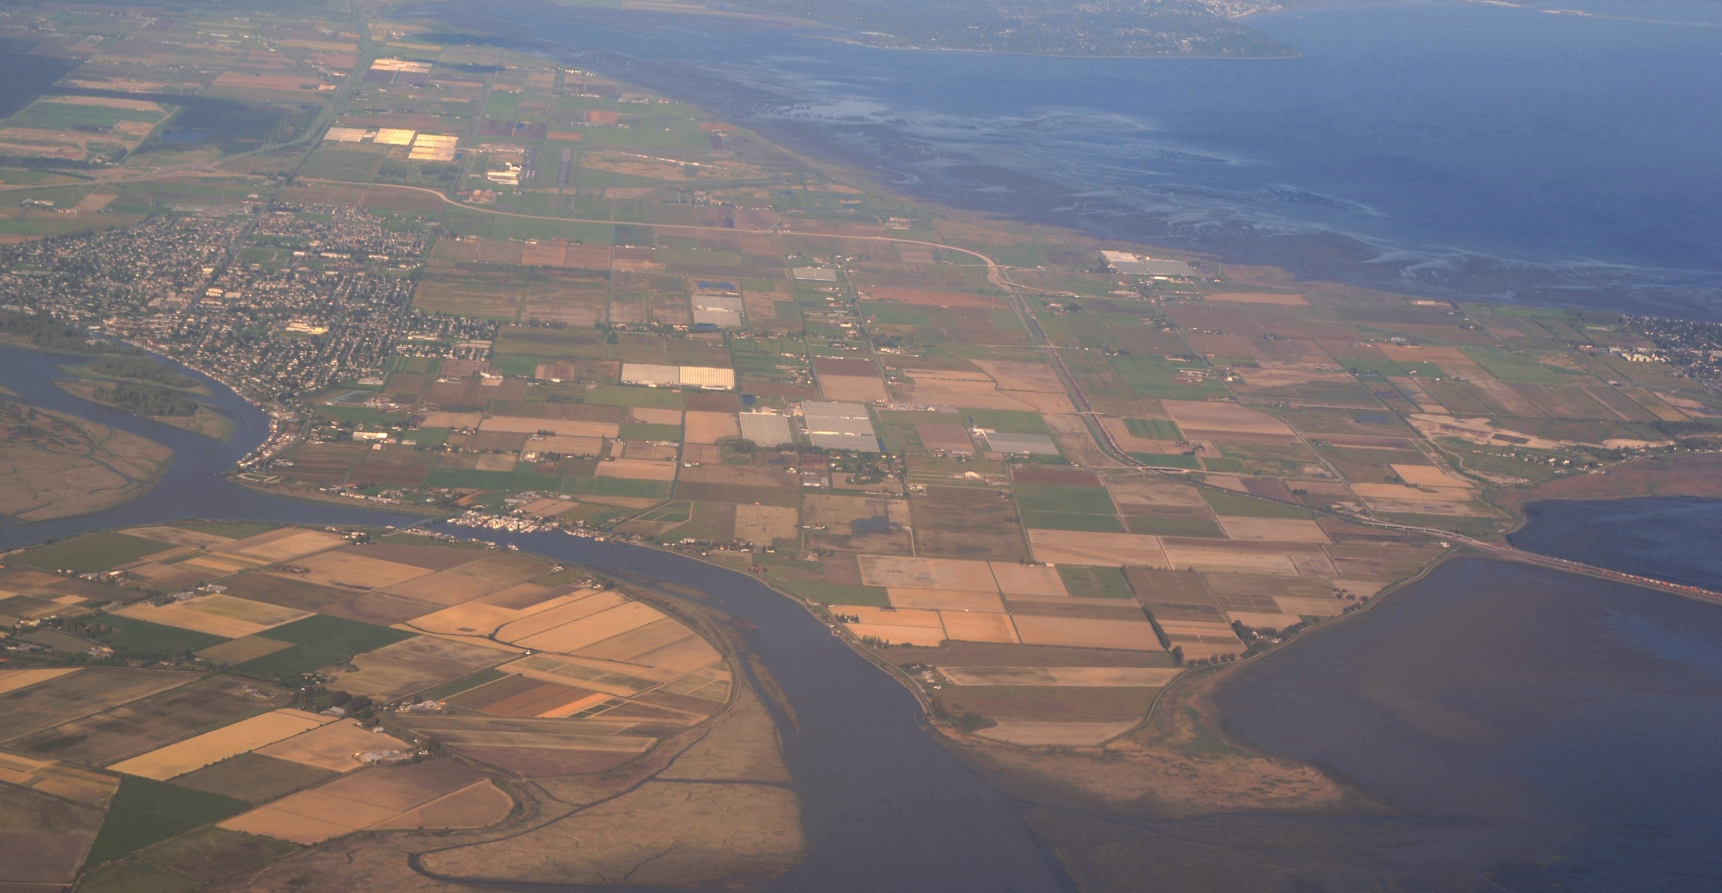

Slide 45
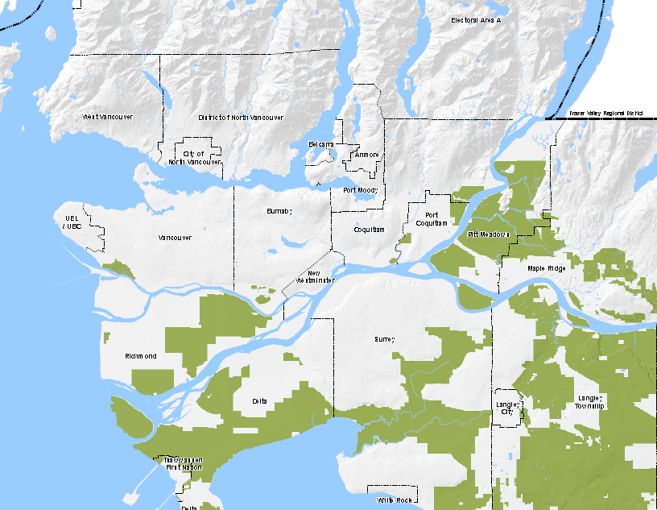
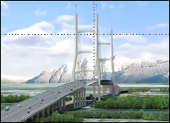
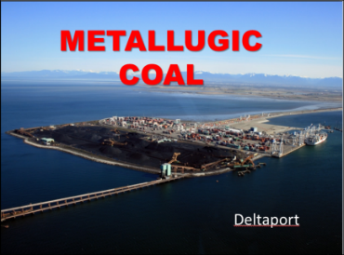
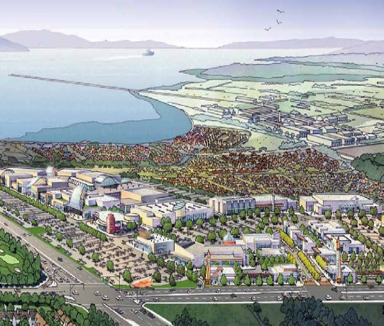
Coal Port
Massey Bridge
Tsawwassen Mills
TSAWWASSEN MILLS
WER CENTRE

Slide 46
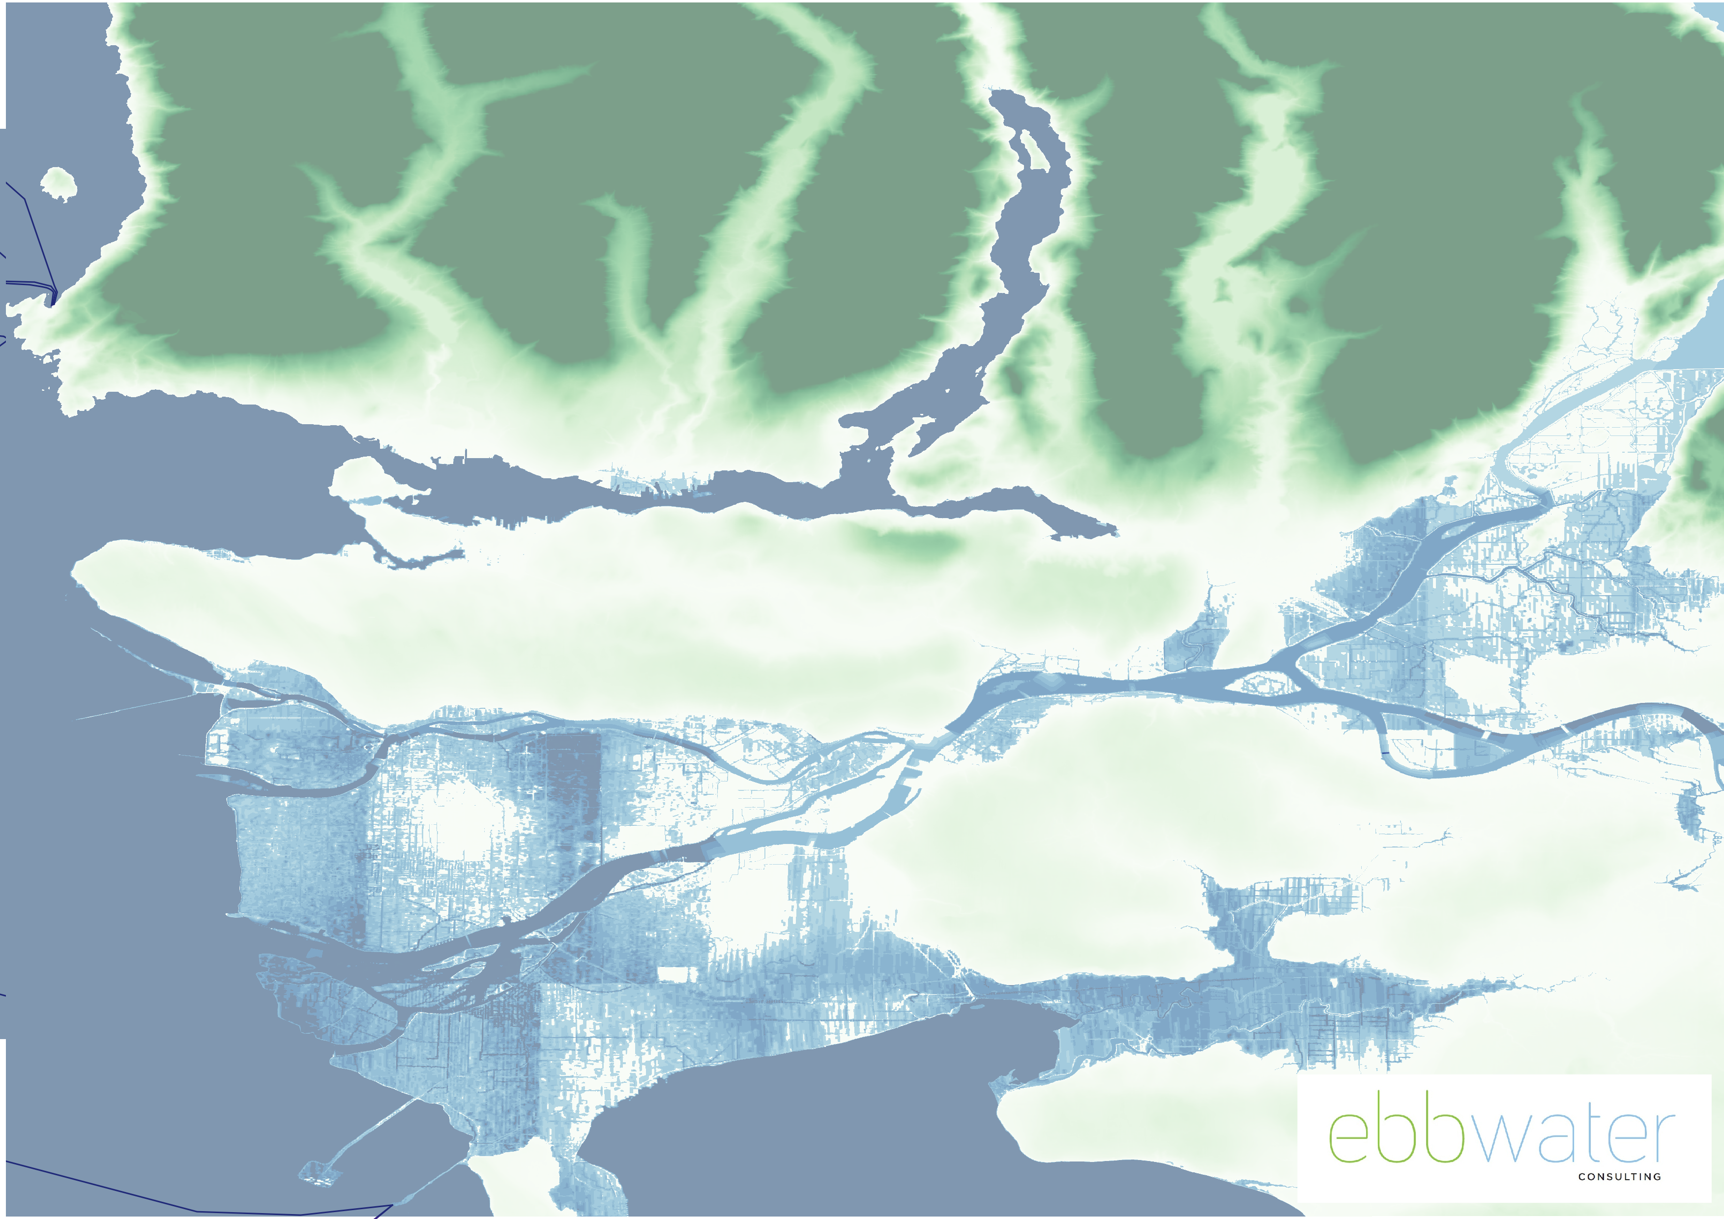
One Meter Rise in Sea Level

Slide 47
What do we expect for our future?

Slide 48
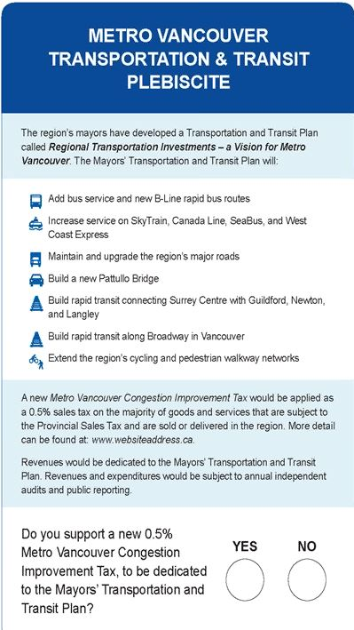
Transportation Referendum

Slide 49
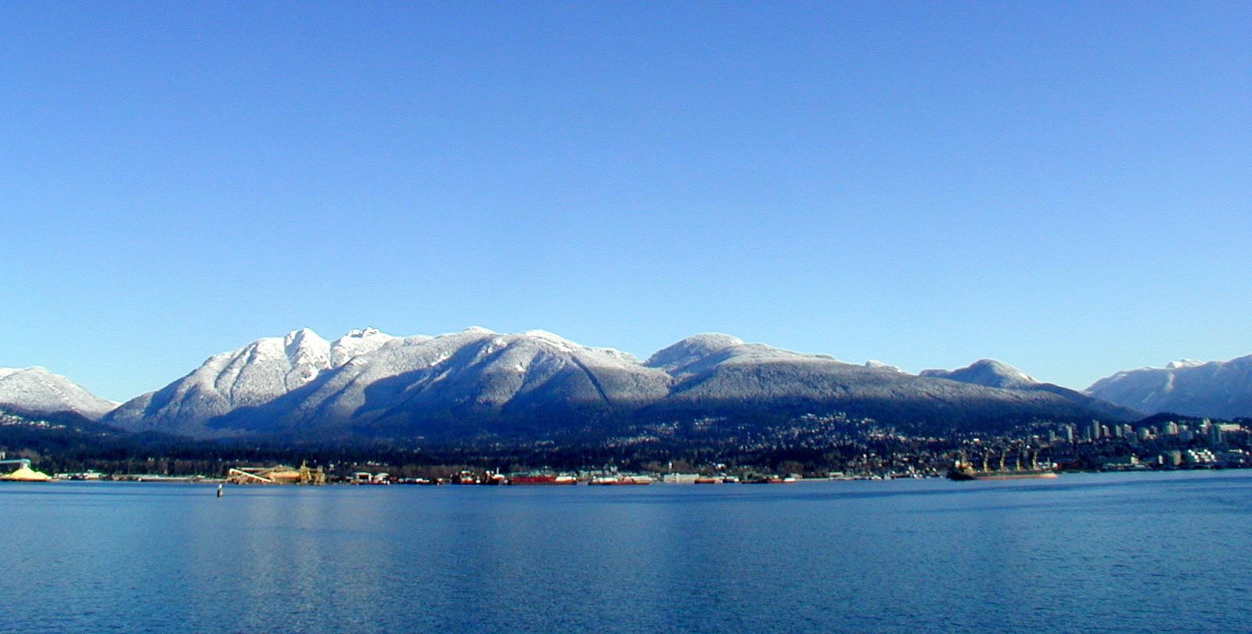
Price Tags
pricetags.wordpress.com

